Slide 1
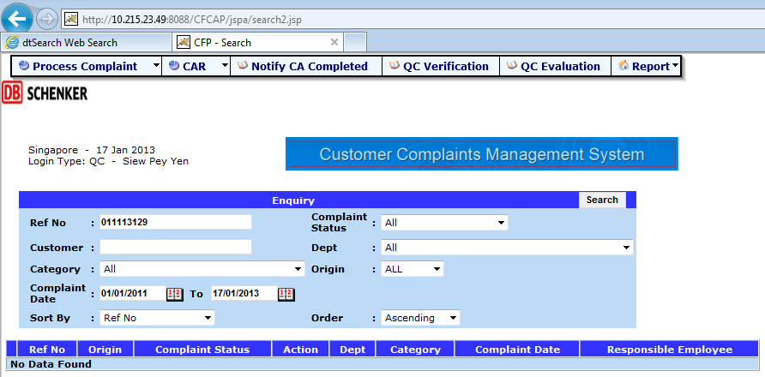
Bugs in Current System
1. The search function in the first page is not working
Data not found

Slide 2
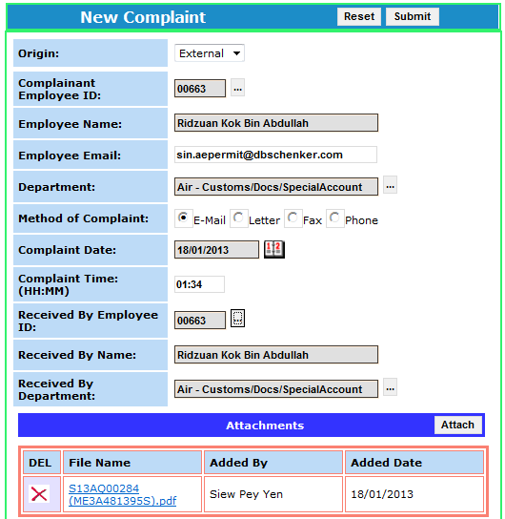
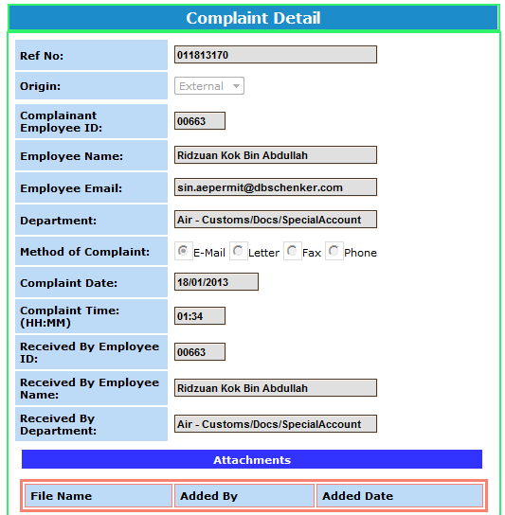
Bugs in Current System
2. All attachments are missing upon submission if the complainant and/or receiver are not the same as the person who uploaded the files.
Before submission
After submission
No attachment after submisson

Slide 3
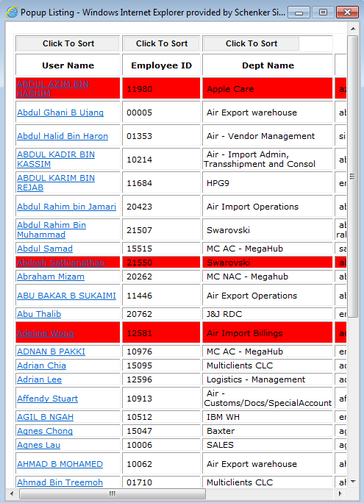
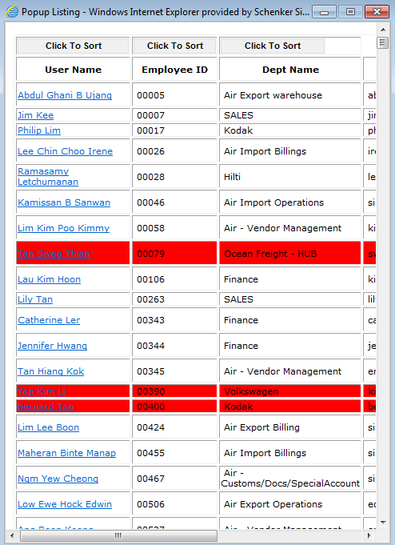
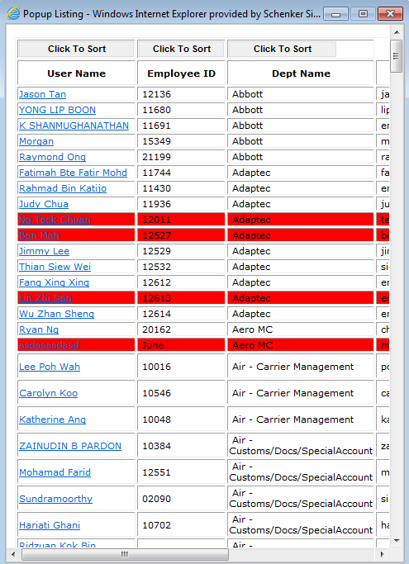


Bugs in Current System
3. Incomplete employee list (GSD#1231578). Bug not solved yet.
Sort by user name
Sort by employee ID
Sort by Dept name
All lists are incomplete

Slide 4
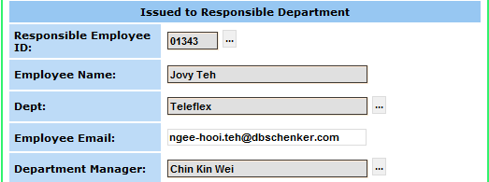

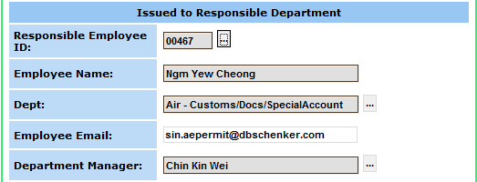
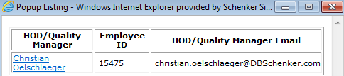
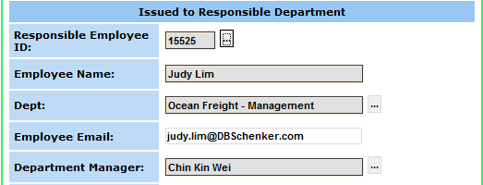

Bugs in Current System
4. Auto fill-up for department manager
Must manually change the department manager

Slide 5
Bugs in Current System
5. Please check and update database (i.e. department manager) as per below:
Division | Department | HOD
*all division | Sales | Agnes Lau
*all division | MD Office Dept | Charlie Kok
*all division | MD Office Division | Charlie Kok
Security | Security | Charlie Kok
*all division | Logisitcs Division | Chin Kin Wei
*all division | Logistics General | Chin Kin Wei
*all division | Logistics Warehouse | Chin Kin Wei
*all division | Information Technology | Chong Yuit Oon
*all division | Air General | Christian Oelschlaeger
*all division | Airfreight | Christian Oelschlaeger
*all division | HR General | Hannah Ong
*all division | Fairs and Exhibitions | Joseph Lam
*all division | Finance | Lau Kim Hoon
*all division | Finance General | Lau Kim Hoon
Warehouse | Special Projects | Jeong Chang Sub
Oil and Gas | Special Projects | Patrick Wee
Special Project - EPC | Special Projects | Patrick Wee
Special Project - Military | Special Projects | Patrick Wee
Vetco Gray | Special Projects | Patrick Wee
*all division | Ocean Freight General | Simon Burrows
*all division | Quality | Yanto Tan
*all division | Quality General | Yanto Tan

Slide 6
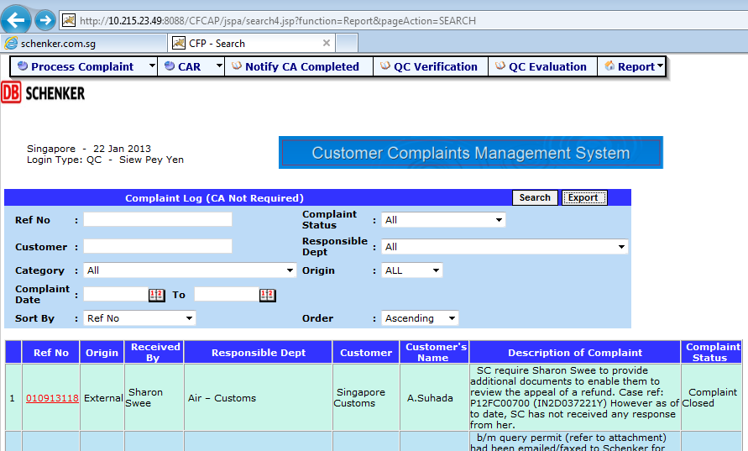
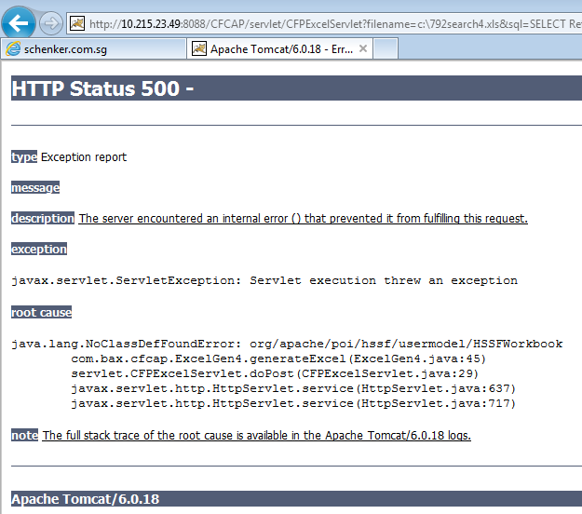
Bugs in Current System
6. Error while exporting data into excel from CCMS
Error message

Slide 7
Bugs in Current System
7. Delay in receiving message from CCMS. All message should be received almost instantly. Current observation is 2 days in delay.

Slide 8
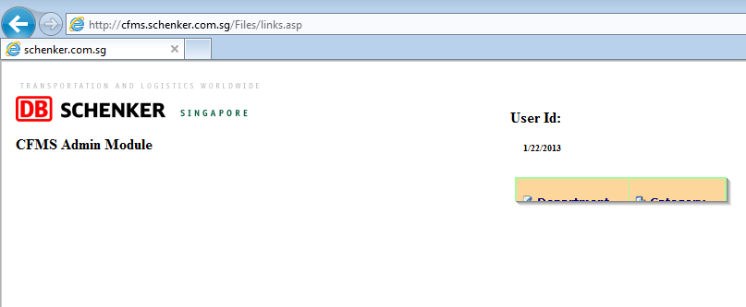
Bugs in Current System
8. CCMS Admin page is not loaded completely & correctly.
User ID not shown
CCMS, not CFMS
Truncated

Slide 9
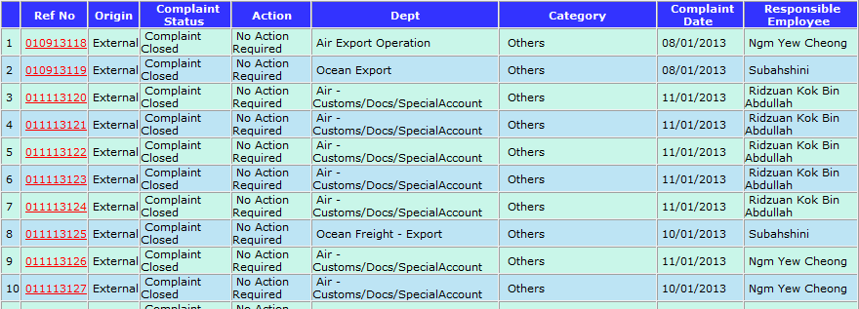
Current System Enhancement
1. Column “Action” : Change “No action required” to “-” for all complaint closed cases to avoid confusion.

Slide 10
Current System Enhancement
2. IT announcement on system up/down/maintenance time pertaining to CCMS

Slide 11
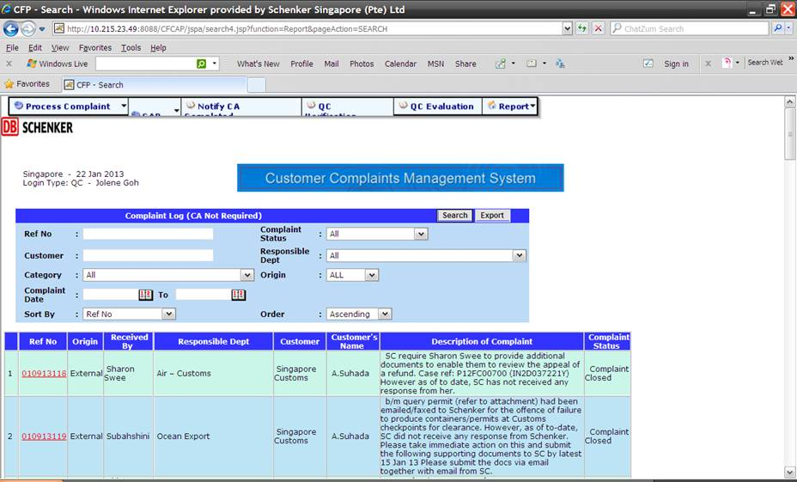
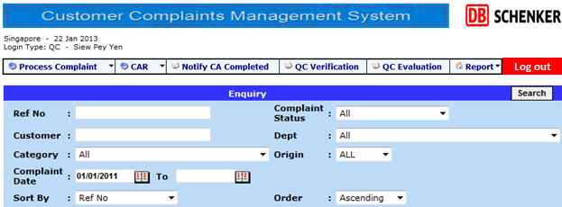
Current System Enhancement
3. Improved interface design for CCMS top panel
Current view
Truncated & floating panel
No “log out” button
Different width for different section
Proposed view
Company logo & page title at the top of the page
Non-truncated & static panel
With “Log out” button
Fixed width for all section (neater look)

Slide 12
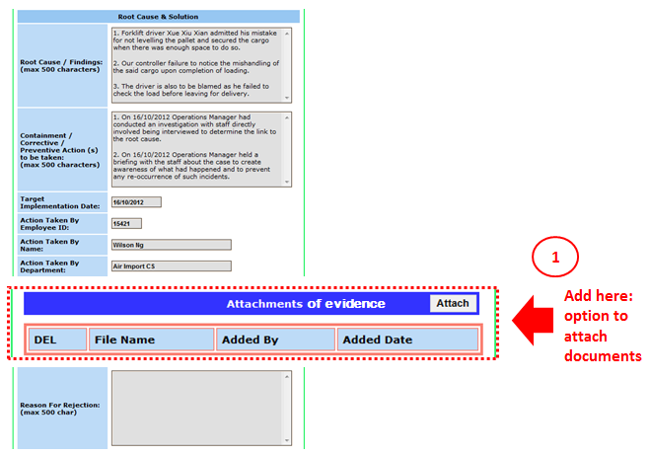
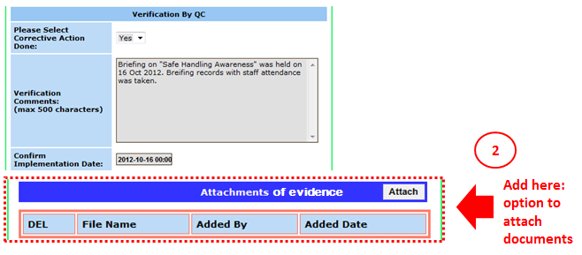
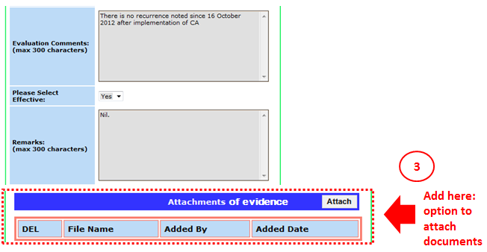
Current System Enhancement
In progress
4. New attachment button for the sections below (GSD#1228193)
“Root cause & Solutions” section
“Verification by QC” section
“Evaluation by QC” section

Slide 13
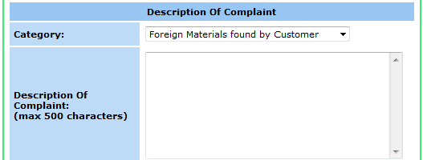
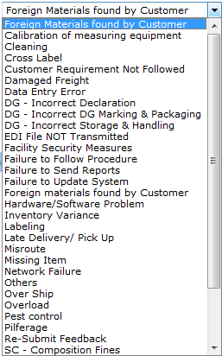
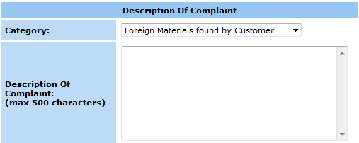
New Functions
1. Clean up existing category database & add new category into database
Today’s view | Proposed view
 | Change the category list from the current list to only four main categories: 8D report Customer feedback Dangerous goods Singapore Customs Proposed view:
Current Category List:
Select a category
8D report
Customer Feedback
Dangerous Goods
Singapore Customs

Slide 14

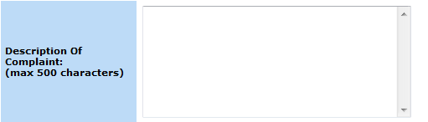
New Functions
1a. First scenario if “8D report” is selected…
Today’s view | Proposed view
 | Proposed view when “8D report” is the selected category: List of corresponding sub-category will be shown.
Please refer to slide #19 for full sub-category list
8D report
Sub-category:
Select a sub-category
8D report

Slide 15
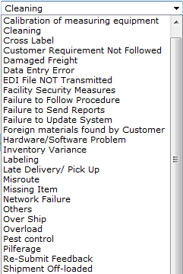

New Functions
1b. Second scenario if “Customer Feedback” is selected…
Today’s view | Proposed view
 | Proposed view when “Customer Feedback” is the selected category: List of corresponding sub-category will be shown.
Customer Feedback
Sub-category:
Select a sub-category
Please refer to slide #19 for full sub-category list

Slide 16
New Functions
1c. Third scenario if “Dangerous Goods” is selected…
Today’s view | Proposed view
 | Proposed view when “Dangerous Goods” is the selected category: List of corresponding sub-category will be shown.
Please refer to slide #19 for full sub-category list
Dangerous Goods
Sub-category:
Select a sub-category
Incorrect Declaration
Incorrect DG Marking & Packaging
Incorrect Storage & Handling

Slide 17
New Functions
1d. Forth scenario if “Singapore Customs” is selected…
Today’s view | Proposed view
 | Proposed view when “Singapore Customs” is the selected category: List of corresponding sub-category & fields will be shown.
Singapore Customs
Sub-category:
Select a sub-category
Please refer to slide #19 for full sub-category list, department list & “Incurred by” list.
Failure to …
Failure to …
Reason for Fines & Composition Fees Imposed if “others” is selected
Department:
Select a department
Declarant:
Ref Number (on offer of composition letter):
Mandatory fields (i.e. user cannot submit the record if any of these field is left blank
Permit Number:
Shipment Number:
Fine Amount (SGD):
Date of Fine paid to Custom
Incurred by:
Select a party

Slide 18
New Functions
1e. Sub category list, department list & “Incurred by” list when different category is selected:
Category | Subcategory
8D report | 8D report
Customer Feedback | Calibration of measuring equipment
 | Cleaning
 | Cross label
 | Customer requirement not followed
 | Damaged freight
 | Data entry error
 | EDI file not transmitted
 | Facility security measures
 | Failure to follow procedure
 | Failure to send reports
 | Failure to update system
 | Foreign materials found by customer
 | Hardware / software problem
 | Inventory variance
 | Labeling
 | Late delivery / pick up
 | Misroute
 | Missing item
 | Network failure
 | Others
 | Over ship
 | Overload
 | Pest control
 | Pilferage
 | Re-submit feedback
 | Shipment off-load
 | Short shipment
 | Temperature and RH excursion
 | Wrong shipment
 | Wrong storage requirement
 | Wrong / late billing
Category | Subcategory | Department | Incurred by
Dangerous Goods | Incorrect Declaration
 | Incorrect DG Marking & Packaging
 | Incorrect Storage & Handling
Singapore Customs | Failure to cancel unused permit within 24 hours | Air Export | Schenker
 | Failure to endorse at customs checkpoint | Air Import | Vendor
 | Failure to produce customs permit / goods / container for clearance | Fair & Exhibition
 | Failure to return documents | Global Projects
 | Late in submission disposal documents to customs | Logistics
 | MRS not submitted | Ocean Export
 | Non-Payment of customs duty/GST | Ocean Import
 | Others | Ocean KA
 | Wrong declaration – cargo packing type | Oil & Gas
 | Wrong declaration – container no.
 | Wrong declaration – CR no.
 | Wrong declaration – currency
 | Wrong declaration – EI/UEN no.
 | Wrong declaration – GST short declared
 | Wrong declaration – HS code
 | Wrong declaration – origin of goods
 | Wrong declaration – place of release
 | Wrong declaration – quantity
 | Wrong declaration – value
 | Wrong declaration – weight

Slide 19
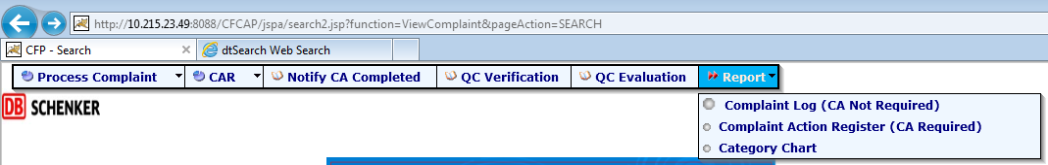
New Functions
2. Report generation for different types of report
8D report
Customer feedback report
Dangerous goods report
Composition fine report
Customer feedback sub-category chart

Slide 20
New Functions
3a. Export data into excel (8D report)
Report type | Columns to export | Column name
8D report | CCMS Ref no. Department of receiver Department of complainant Department of responsible employee Company’s name Category Sub-category Description of complaint Correct action report due date Comment Root cause / Findings Containment / Corrective / Preventive Actions to be taken Target implementation date Action taken by name Verification comments Confirm implementation date Evaluation comments Please select effective Complaint status Complaint date New complaint creation date Complaint closed date | Ref no. Receiver Issue owner Action owner Customer Category Sub-category Description of complaint CAR due date Comment Root cause / Findings Containment / Corrective / Preventive Actions Target implementation date Action by Verification comments Implementation date Evaluation comments Effectiveness Complaint status Complaint date Complaint creation date Complaint closed date

Slide 21
New Functions
3b. Export data into excel (Customer feedback report)
Report type | Columns to export | Column name
Customer Feedback report | CCMS Ref no. Origin Department of receiver Department of complainant Department of responsible employee Company’s name Category Sub-category Description of complaint Correct action report due date Comment Root cause / Findings Containment / Corrective / Preventive Actions to be taken Target implementation date Action taken by name Verification comments Confirm implementation date Evaluation comments Please select effective Complaint status Complaint date New complaint creation date Complaint closed date | Ref no. Origin Receiver Issue owner Action owner Customer Category Sub-category Description of complaint CAR due date Comment Root cause / Findings Containment / Corrective / Preventive Actions Target implementation date Action by Verification comments Implementation date Evaluation comments Effectiveness Complaint status Complaint date Complaint creation date Complaint closed date

Slide 22
New Functions
3c. Export data into excel (Dangerous Goods)
Report type | Columns to export | Column name
Customer Feedback report | CCMS Ref no. Origin Department of receiver Department of complainant Department of responsible employee Company’s name Category Sub-category Description of complaint Correct action report due date Comment Root cause / Findings Containment / Corrective / Preventive Actions to be taken Target implementation date Action taken by name Verification comments Confirm implementation date Evaluation comments Please select effective Complaint status Complaint date New complaint creation date Complaint closed date | Ref no. Origin Receiver Issue owner Action owner Customer Category Sub-category Description of complaint CAR due date Comment Root cause / Findings Containment / Corrective / Preventive Actions Target implementation date Action by Verification comments Implementation date Evaluation comments Effectiveness Complaint status Complaint date Complaint creation date Complaint closed date

Slide 23
New Functions
3d. Export data into excel (Composition Fines Report)
Report type | Columns to export | Column name
Composition Fines Report | CCMS Ref no. Department of receiver Department of complainant Department of responsible employee Category Sub-category Reason for Fines & Composition Fees Imposed if “others” is selected Department Declarant Ref Number (on offer of composition letter) Permit Number Shipment Number Fine Amount (SGD) Date of Fine paid to Custom Incurred by | Ref no. Receiver Issue owner Action owner Category Reason for Fines & Composition Fees Imposed Reason for Fines & Composition Fees Imposed if “others” is selected Department Declarant Ref Number (on offer of composition letter): Permit Number Shipment Number Fine Amount (SGD) Date of Fine paid to Custom Incurred by

Slide 24
New Functions
4. Allow CCMS admin to edit category & sub-category list from CCMS Admin page

